Slide 1

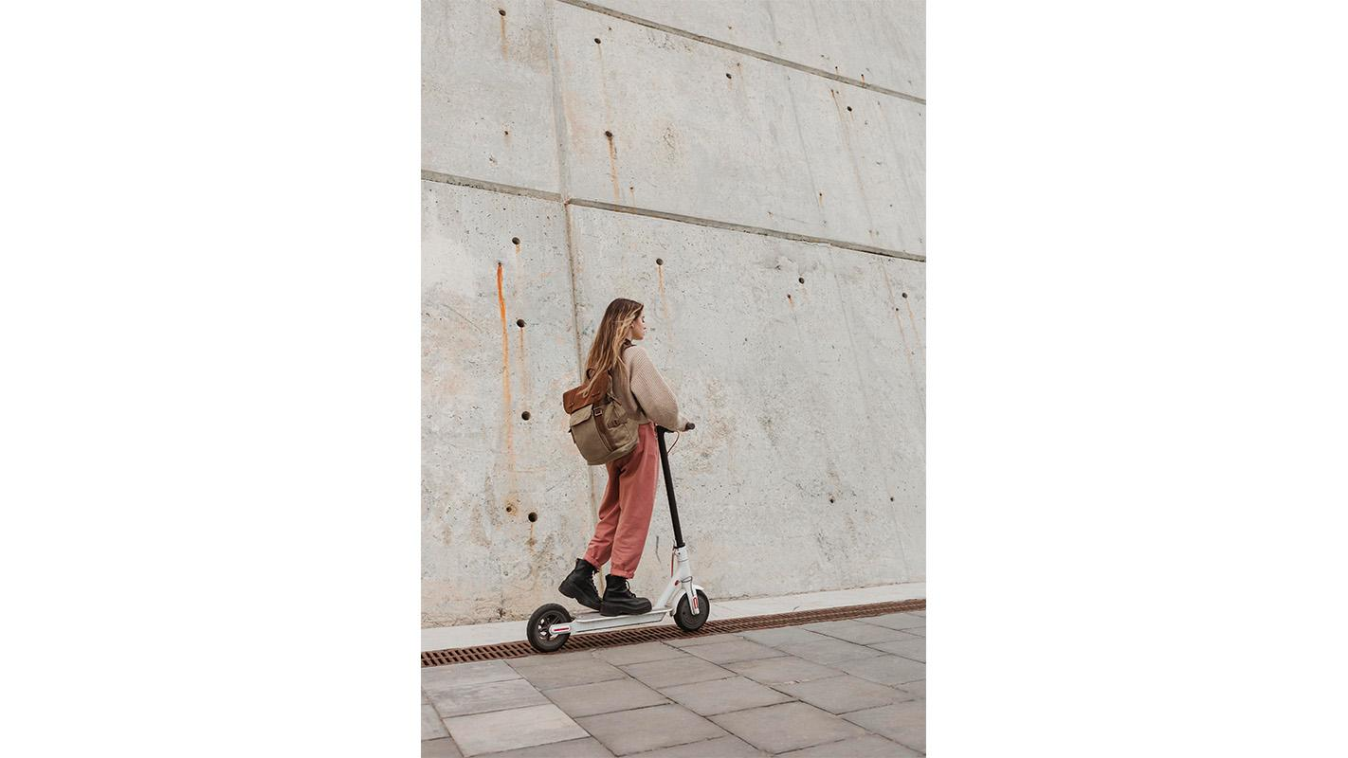
ScooPark Guarda, vive, avanza

Slide 2
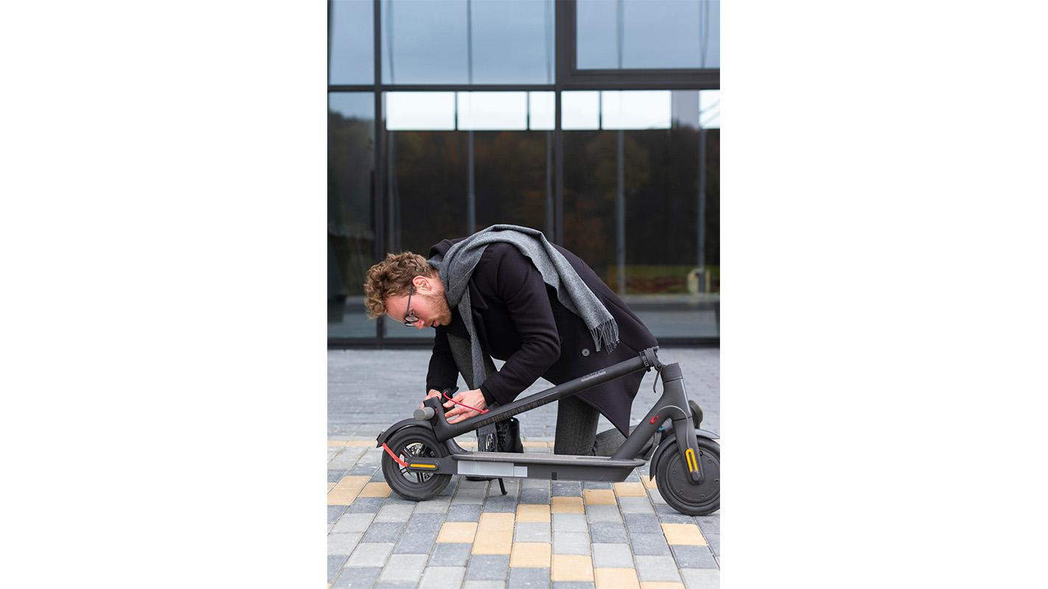
Planteamineto del Problema
Falta de Espacios de Estacionamiento Específicos
Seguridad y Protección de los Scooters
Integración con el Transporte Público
Normativas y Regulaciones Inexistentes o Ambiguas
Necesidad de Carga y Mantenimiento
Concientización y Educación Pública

Slide 3
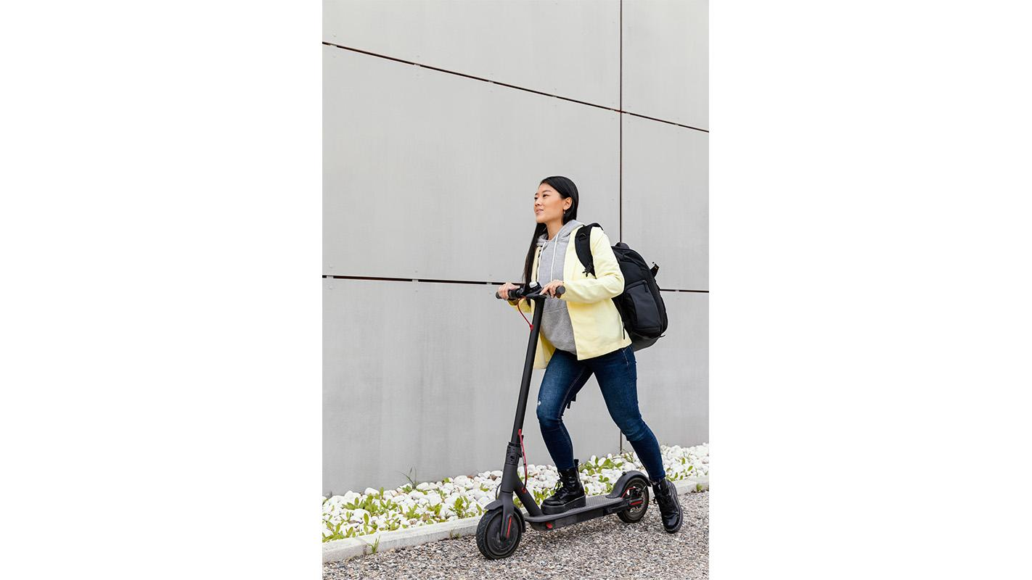
Solución del Problema
Para abordar los desafíos planteados, se propone la implementación de un sistema integral de estacionamientos para scooters y bicicletas, respaldado por una aplicación centralizada que ofrece acceso a todos los estacionamientos disponibles en la zona. A continuación, se detallan los elementos clave de esta solución:
Aplicación Centralizada
Reserva y Apertura Remota de Estacionamientos
Sistema de Pago Integrado
Carga y Mantenimiento
Alertas y Guiado del Usuario:
Normativas y Regulaciones

Slide 4
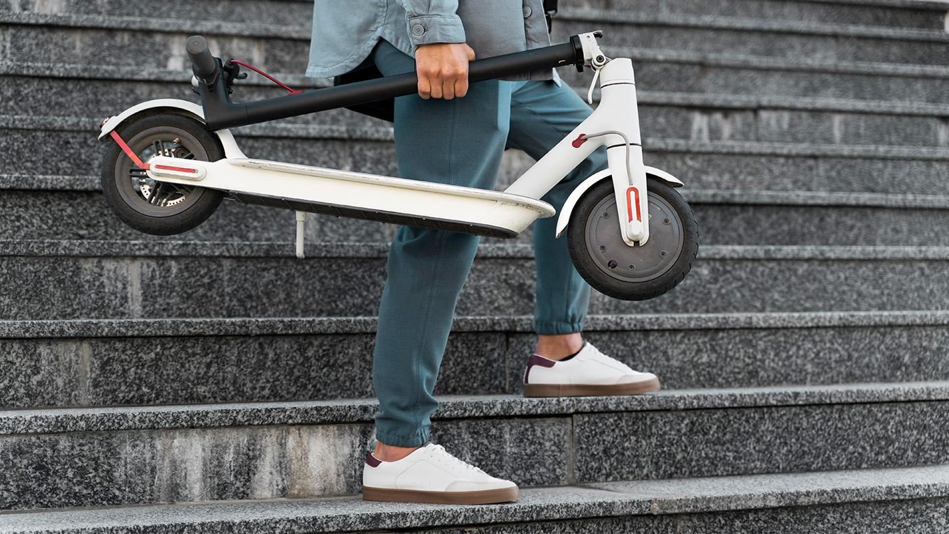
A picture is worth a thousand words

Slide 5
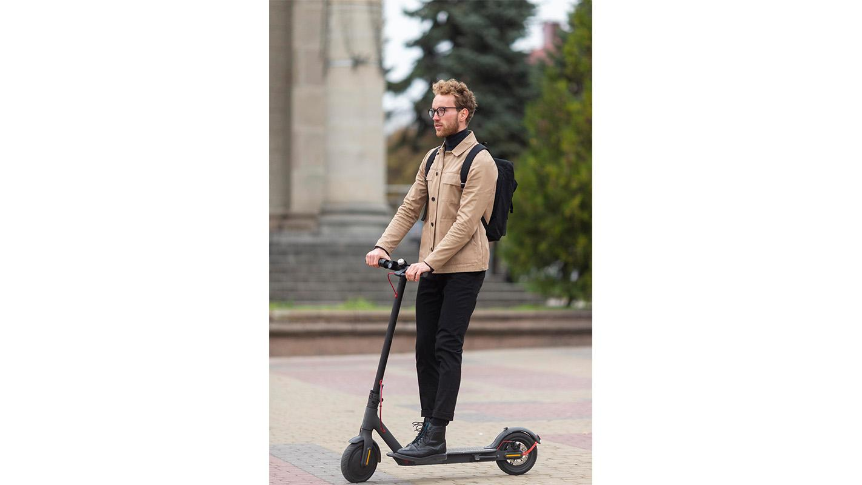
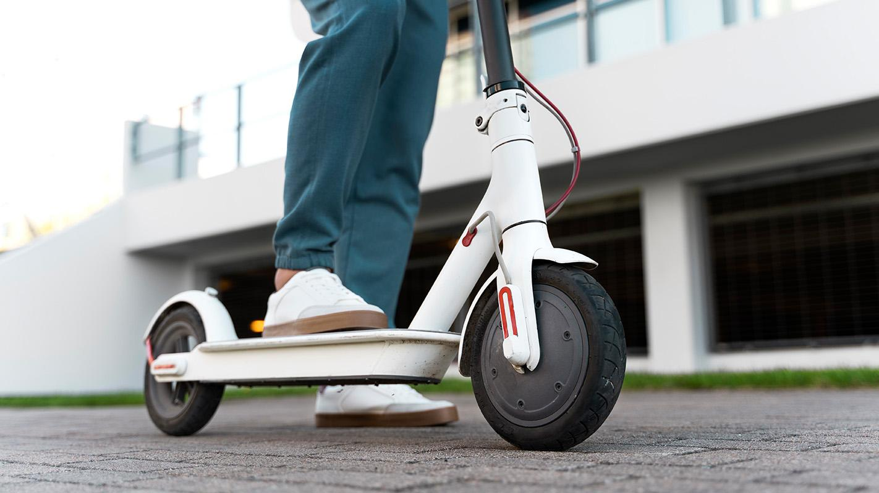
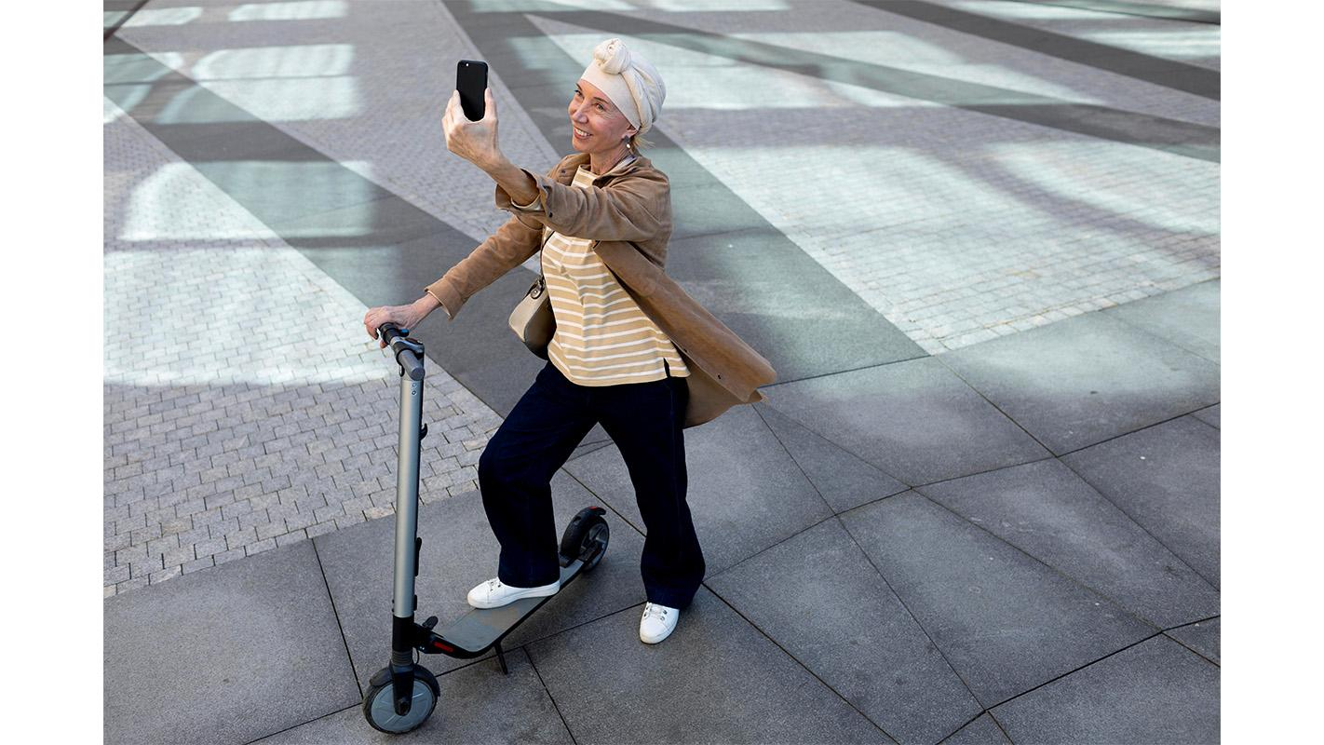
Best sellers
01
02
03
Venus
Mars
Saturn
Venus is the second planet from the Sun
Despite being red, Mars is a cold place
Saturn is a gas giant and has several rings

Slide 6
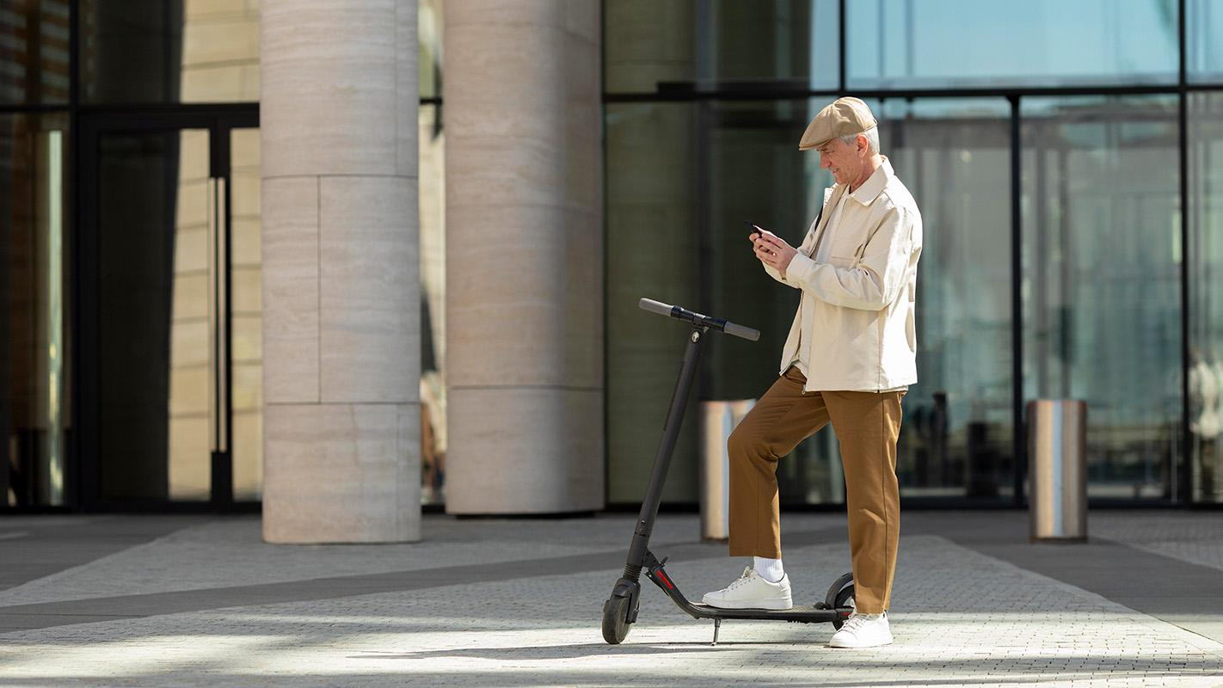
Our strengths
Easy to use
No pollution
Low costs
Maintenance
Venus is the second planet from the Sun
It’s the biggest planet in the Solar System
Despite being red, Mars is a cold place
Saturn is a gas giant and has several rings

Slide 7

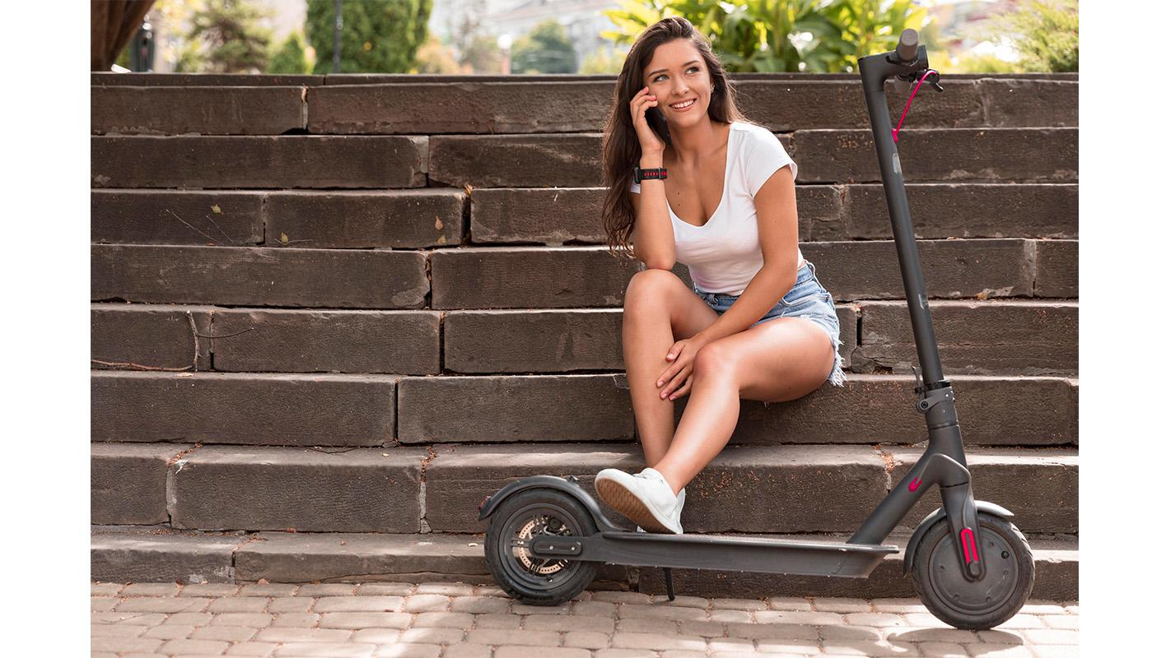
Customer profile
Ages
16-25
30%
Gender
26-35
70%
36-45
10%
Women
30%
Follow the link in the graph to modify its data and then paste the new one here. For more info, click here
Interests
Music
35%
Men
Nature
50%
70%
Environment
90%

Slide 8
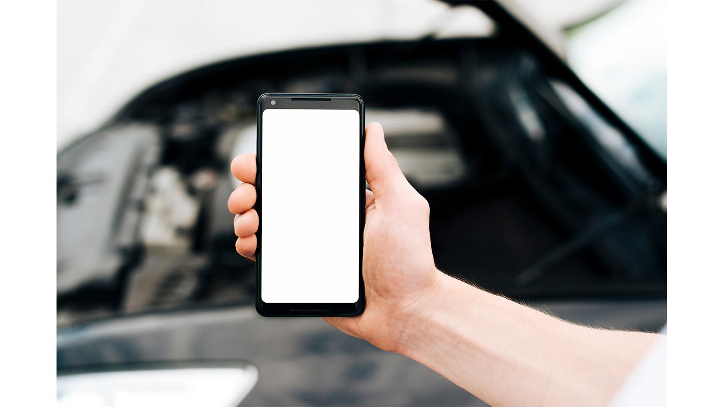

Mockup!
You can replace the image on the screen with your own work. Just right-click on it and select “Replace image”

Slide 9
Awesome words

Slide 10
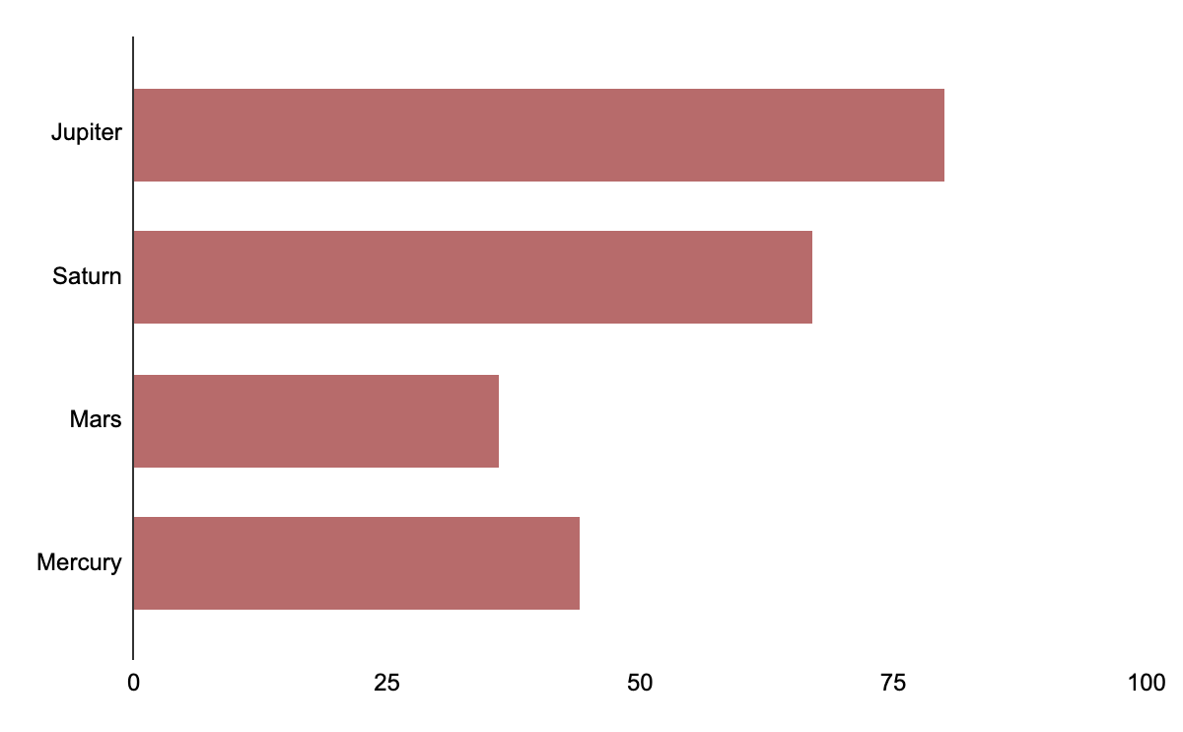
Our numbers
Sales
70%
Market
10%
People
20%
Period 1
Period 2
Follow the link in the graph to modify its data and then paste the new one here. For more info, click here
$2,000,000
Project revenue

Slide 11
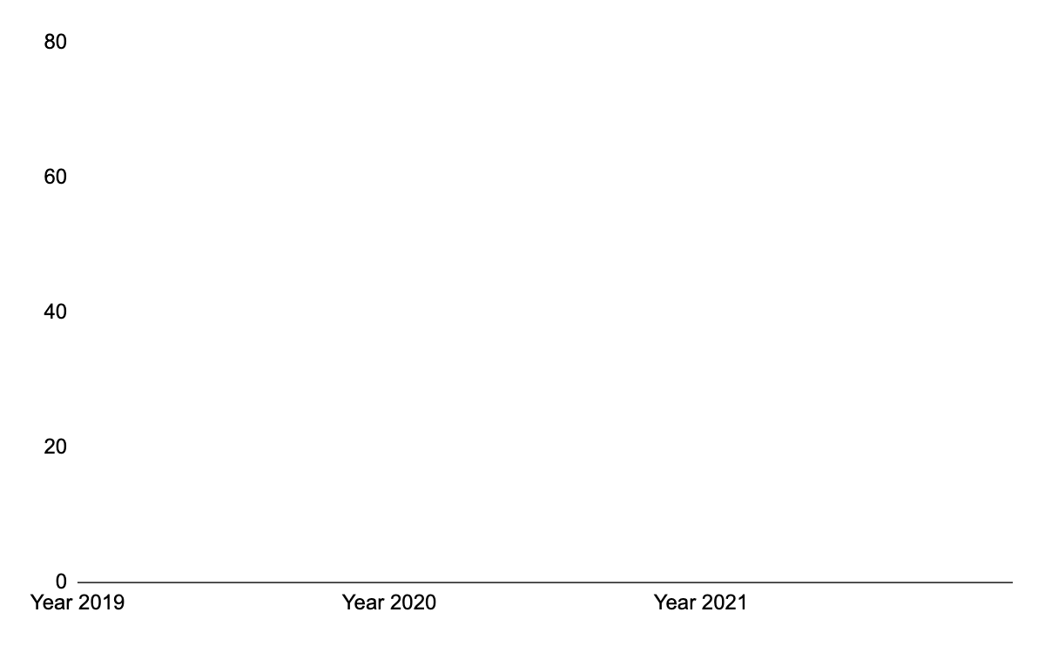
Our growth
$200,000
Expected income for 2020
100
New employees next year
Follow the link in the graph to modify its data and then paste the new one here. For more info, click here

Slide 12
Future projects
Earth
Neptune
01
It’s where we all live on
03
It’s very far away from us
Pluto
02
Ceres
04
It’s now a dwarf planet
It’s in the main asteroid belt

Slide 13
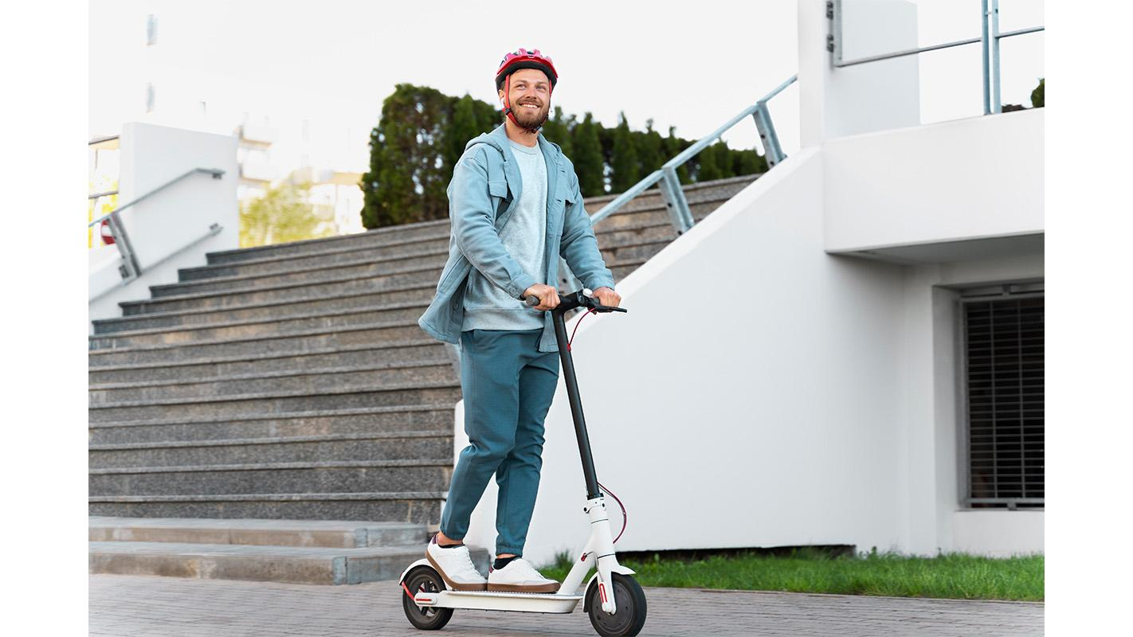
Customer testimonials
Helena James
John Patterson
“It’s the closest planet to the Sun and the smallest one in the Solar System—it’s only a bit larger than the Moon”
“Venus has a beautiful name and is the second planet from the Sun. It’s hot and has a poisonous atmosphere”

Slide 14
Opening hours
 | Mon | Tue | Wed | Thu | Fri | Sat | Sun
Morning | 09:00 13:30 | 09:00 13:30 | 09:00 13:30 | 09:00 13:30 | 09:00 13:30 | 09:00 13:30 | Closed
Afternoon | 09:00 13:30 | 09:00 13:30 | 09:00 13:30 | 09:00 13:30 | 09:00 13:30 | Closed | Closed

Slide 15
Our awards
Award 1
Award 2
Award 3
Venus has a beautiful name and is the second planet from the Sun
It’s the closest planet to the Sun and the smallest in the Solar System
Despite being red, Mars is actually a cold place. It’s full of iron oxide dust

Slide 16
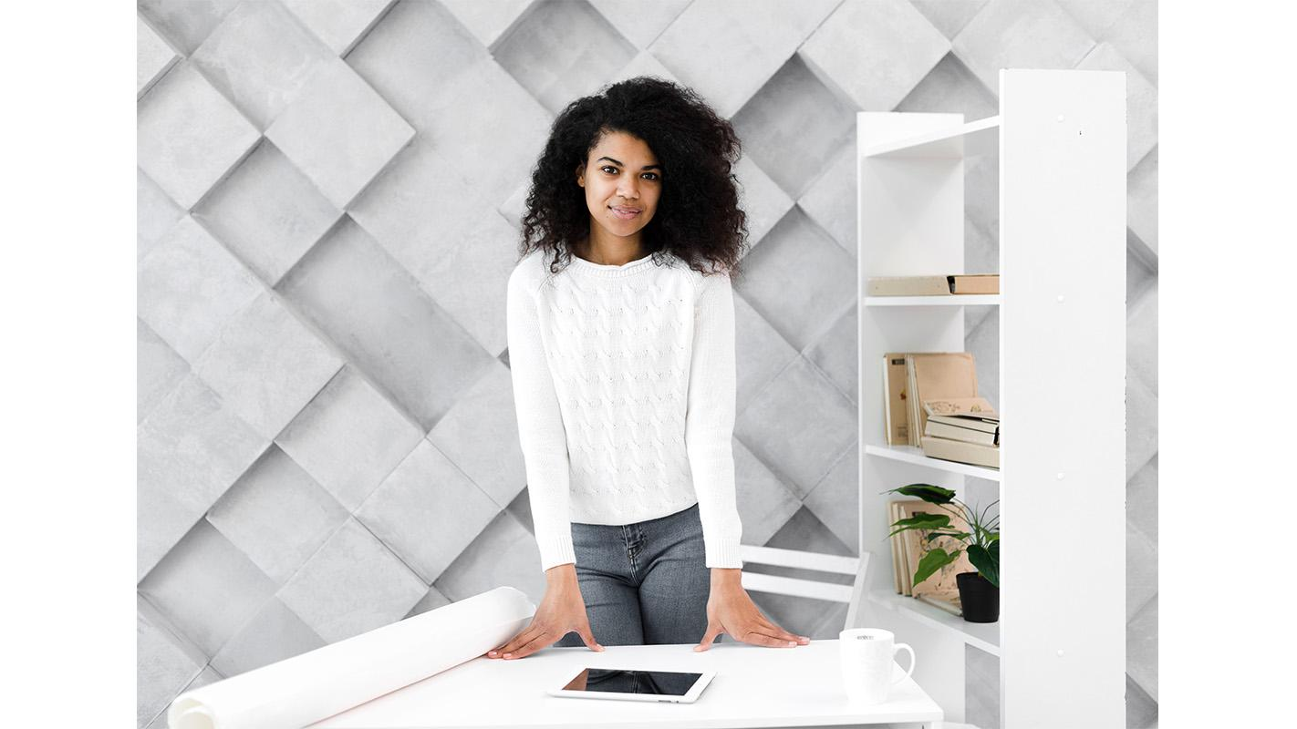

Our team
Jenna Doe
Timmy Jimmy
You can speak a bit about this person here
You can speak a bit about this person here

Slide 17
Thanks!
Do you have any questions?
youremail@freepik.com
+91 620 421 838
yourcompany.com
Please keep this slide for attribution

Slide 18
Self balancing electric scooters icon pack

Slide 19
Alternative resources
Here’s an assortment of alternative resources whose style fits the one of this template
Older man in the city with an electric scooter using smartphone
Young woman riding an electric scooter
Stylish young women riding electric scooter
Young woman riding an electric scooter
Young woman rides in a electrical scooter in the city
Young woman preparing to ride in a electrical scooter in the city
Couple with electric scooters outdoors
Casual male riding an electric scooter

Slide 20
Resources
Photos
Young woman riding an electric scooter
Front view man holding phone on e-scooter
Young woman riding an electric scooter
Smiley woman on steps with electric scooter outdoors
Adult male repairing his electric scooter
Young woman with electric scooter
Young man taking a break after riding his scooter outdoors
Casual male posing with an electric scooter
Senior woman with an electric scooter in the city taking a selfie
Older man in the city with an electric scooter using smartphone
Hand holding phone mock-up
Man riding an eco scooter in the city
Portrait of positive young woman posing
Businesspeople meeting at office working

Slide 21
Resources
Vectors
Icons
Gradient inspirational quotes instagram story collection
Self balancing electric scooters

Slide 22
Instructions for use
In order to use this template, you must credit Slidesgo by keeping the Thanks slide.
You are allowed to:
- Modify this template.
- Use it for both personal and commercial projects.
You are not allowed to:
- Sublicense, sell or rent any of Slidesgo Content (or a modified version of Slidesgo Content).
- Distribute Slidesgo Content unless it has been expressly authorized by Slidesgo.
- Include Slidesgo Content in an online or offline database or file.
- Offer Slidesgo templates (or modified versions of Slidesgo templates) for download.
- Acquire the copyright of Slidesgo Content.
For more information about editing slides, please read our FAQs or visit Slidesgo School:
https://slidesgo.com/faqs and https://slidesgo.com/slidesgo-school

Slide 23
Instructions for use (premium users)
As a Premium user, you can use this template without attributing Slidesgo or keeping the "Thanks" slide.
You are allowed to:
Modify this template.
Use it for both personal and commercial purposes.
Hide or delete the “Thanks” slide and the mention to Slidesgo in the credits.
Share this template in an editable format with people who are not part of your team.
You are not allowed to:
Sublicense, sell or rent this Slidesgo Template (or a modified version of this Slidesgo Template).
Distribute this Slidesgo Template (or a modified version of this Slidesgo Template) or include it in a database or in any other product or service that offers downloadable images, icons or presentations that may be subject to distribution or resale.
Use any of the elements that are part of this Slidesgo Template in an isolated and separated way from this Template.
Register any of the elements that are part of this template as a trademark or logo, or register it as a work in an intellectual property registry or similar.
For more information about editing slides, please read our FAQs or visit Slidesgo School:
https://slidesgo.com/faqs and https://slidesgo.com/slidesgo-school

Slide 24
Fonts & colors used
This presentation has been made using the following fonts:
Krona One
(https://fonts.google.com/specimen/Krona+One)
Work Sans
(https://fonts.google.com/specimen/Work+Sans)
#404040
#b76b6b
#e9cfc0
#b9af9d
#000000

Slide 25





Storyset
Create your Story with our illustrated concepts. Choose the style you like the most, edit its colors, pick the background and layers you want to show and bring them to life with the animator panel! It will boost your presentation. Check out How it Works.
Pana
Amico
Bro
Rafiki
Cuate

Slide 26
Use our editable graphic resources...
You can easily resize these resources without losing quality. To change the color, just ungroup the resource and click on the object you want to change. Then, click on the paint bucket and select the color you want. Group the resource again when you’re done. You can also look for more infographics on Slidesgo.

Slide 29
JANUARY
FEBRUARY
MARCH
APRIL
MAY
JUNE
PHASE 1
Task 1
Task 2
PHASE 2
Task 1
Task 2
JANUARY
FEBRUARY
MARCH
APRIL
PHASE 1
Task 1
Task 2

Slide 32
...and our sets of editable icons
You can resize these icons without losing quality.
You can change the stroke and fill color; just select the icon and click on the paint bucket/pen.
In Google Slides, you can also use Flaticon’s extension, allowing you to customize and add even more icons.

Slide 33
Educational Icons
Medical Icons

Slide 34
Business Icons
Teamwork Icons

Slide 35
Help & Support Icons
Avatar Icons

Slide 36
Creative Process Icons
Performing Arts Icons

Slide 37
Nature Icons

Slide 38
SEO & Marketing Icons

Slide 39


